Slide 1
Predicting Avocado Prices with Machine Learning
By: Cesar, Sarah, and Amanuel

Slide 2
Problem..?
Avocado prices are high. What factors can be used to predict prices?

Slide 3
Data
Originates from the Hass Avocado Board.
Our dataset comes from Kaggle:
Vakharia Pujan
Justin Kiggins
Valentin Joseph

Slide 4
Methodology
We use Regressive Machine Learning Models to predict avocado prices.
Linear Regression
Neural Network
Decision Tree Regression
Random Forest Regressor

Slide 5
Preprocessing
Remove markets
Map regions to markets
Create avocado, region, market, type tables
Save tables as CSVs
Create table schema in PostgreSQL
Import CSVs

Slide 6
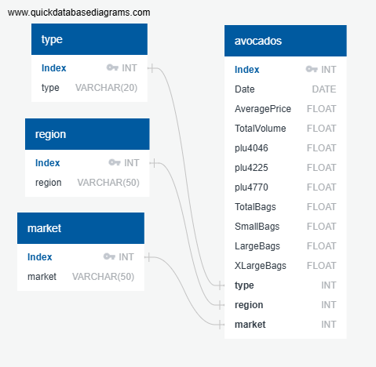

Slide 7
Models
Target Value: average prices
Features:
Plu4046 | Type
Plu4225 | Region
Plu4770 | Market
Total Bags | Quarter

Slide 8
Results
Linear Regression: 0.58
Neural Network: -1.17
Decision Tree Regression: 0.66
Random Forest Regressor: 0.84

Slide 9
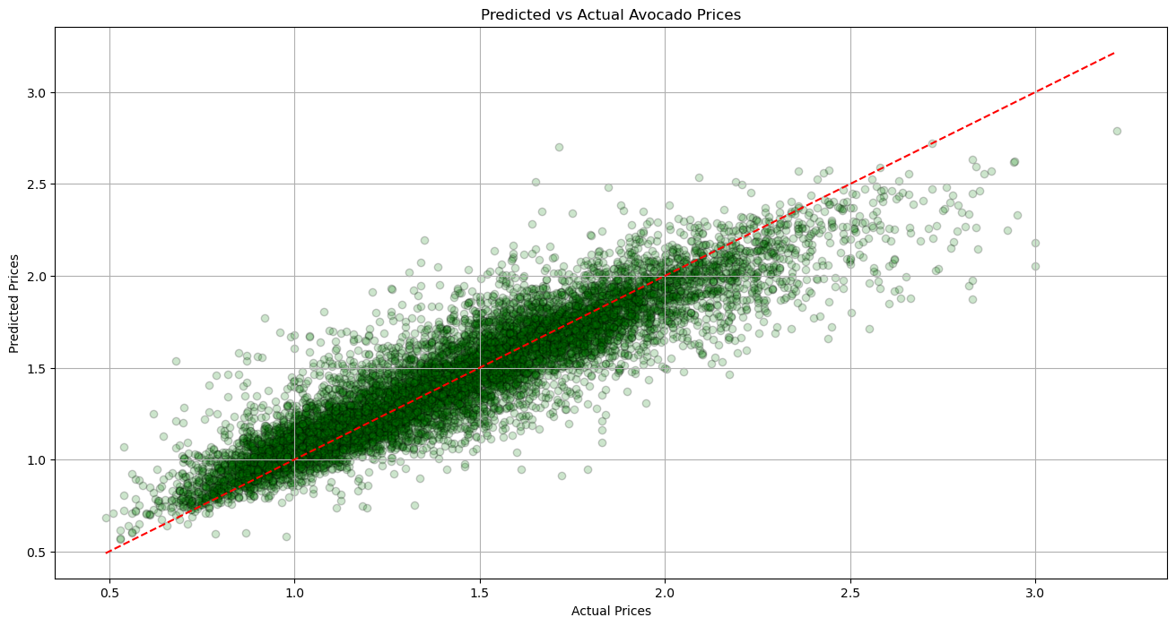

Slide 10
In Conclusion
Random Forest Regression yielded our highest r2 score. This could be explained by flexibility of the Random Forest Algorithm.

Slide 11
Future Analysis
Future Analysts could consider factors such as:
Size of dataset
Time
Number of features
Using a different Machine Learning Model

Slide 12

The End

